Slide 1
Employee Data Analysis using Excel
STUDENT NAME: R. AISHWARYA
REGISTER NO:122202131
NAAN MUDHALVAN:asunm1353122202131
DEPARTMENT:B.COM (CORPORATE SECRETARYSHIP)
COLLEGE: ANNA ADARSH COLLEGE FOR WOMEN

Slide 2
PROJECT TITLE
Employee Performance Analysis using Excel

Slide 3


AGENDA
Problem Statement
Project Overview
End Users
Our Solution and Proposition
Dataset Description
Modelling Approach
Results and Discussion
Conclusion
3/21/2024 Annual Review

Slide 4

PROBLEM STATEMENT
Utilise Excel To Efficiently Analyse Employee data By Leveraging Functions such as Pivot Table and Conditional formatting.
This enables the identification of key Trends Such as current Employee Rate Performance Level.
The Project Aims to analyse Employee Performance Across Different Business Unit .

Slide 5

PROJECT OVERVIEW
This project focus on Analyzing Employee Data to identify Trends and Insights that can drive better decision.
Excel will be used to clean ,organise,visualize key metrics such as employee demographic performance and retention rate .
The data is processed using excel, there performance levels are determined using a formula, and blank handled VIA conditional formatting and filtering.
The data summarize data is then presented using a pivot table .

Slide 6

WHO ARE THE END USERS?
HR Manager
Team Leader
Departmental Head
Operation Manager
CEO
Senior Management

Slide 7

OUR SOLUTION AND ITS VALUE PROPOSITION
Conditional Formating: Highlights the missing cell
Filter and Sort : Helps to remove the empty cells.
Formula : Helps to identify the performance of the employee.
Pivot Table : Helps to summarise.
Pie chart : To represent the data in a Pictorial manner.

Slide 8
Dataset Description
Employee ID
First Name
Last Name
Business Unit
Employee Type
Employee Classification Type
Gender
Performance Core
Current employee rate
Performance level

Slide 9

THE "WOW" IN OUR SOLUTION
The specific factor in this project is the formula we used =IFS(K8>=5,"VERY HIGH",K8>=4,"HIGH",K8>=3,"MEDIUM",TRUE,"LOW"
3/21/2024 Annual Review

Slide 10
MODELLING
Data Collection
Identification
Gathering
Preparation
Data cleaning
Standardization
Correction
Validation
Summary :
Data analyse involve examining transforming and modelling data to extract meaningful insight, identify patterns , decision making

Slide 11
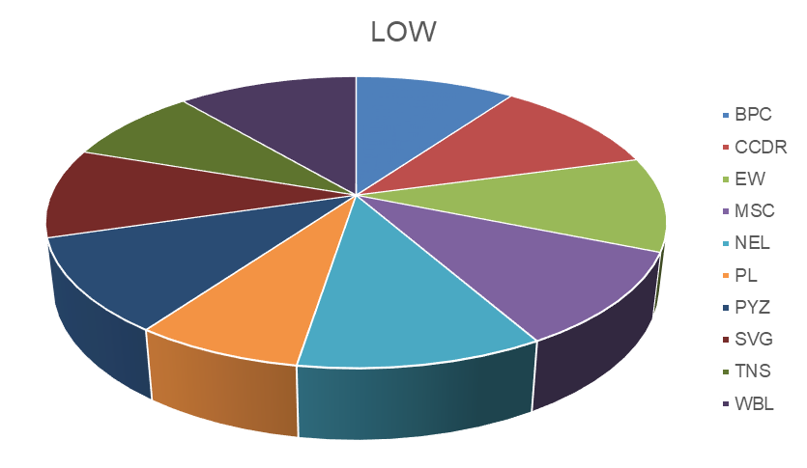
RESULTS

Slide 12
conclusion
In conclusion the employee data analysis conducted using excel provided valuable Insights into work force trends, enabling more informed decision making.
The use of excel allowed for Efficient data organisation, Visualisation , and reporting, Ultimately helping to enhance HR strategies , Improve employee satisfaction.

